Slide 1

How to
Request a Microsoft 365 Workspace
with Orchestry

Slide 2

What is a Workspace?
SharePoint Team Sites
& Communication Sites
Viva Engage Communities
Microsoft Teams

Slide 3
How to Request a Workspace
in Orchestry
1
2
3
4
5
Pick a Template
Give it a Unique Name
Customize
it
Add Members & Guests
Review & Submit Request

Slide 4
Open the Orchestry App in Microsoft Teams

Slide 5
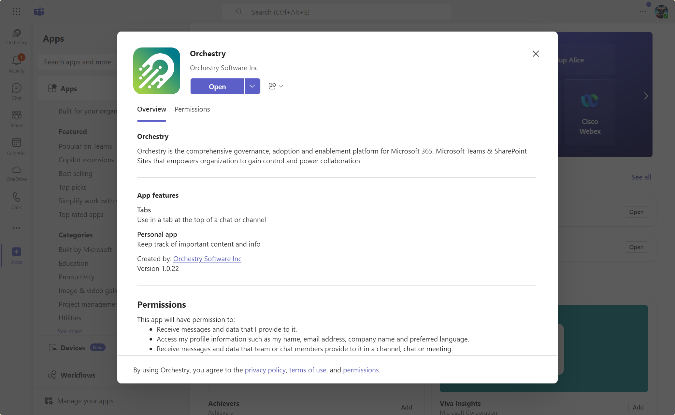
OPEN THE ORCHESTRY APP IN MICROSOFT TEAMS

Slide 6
Select Workspace

Slide 7
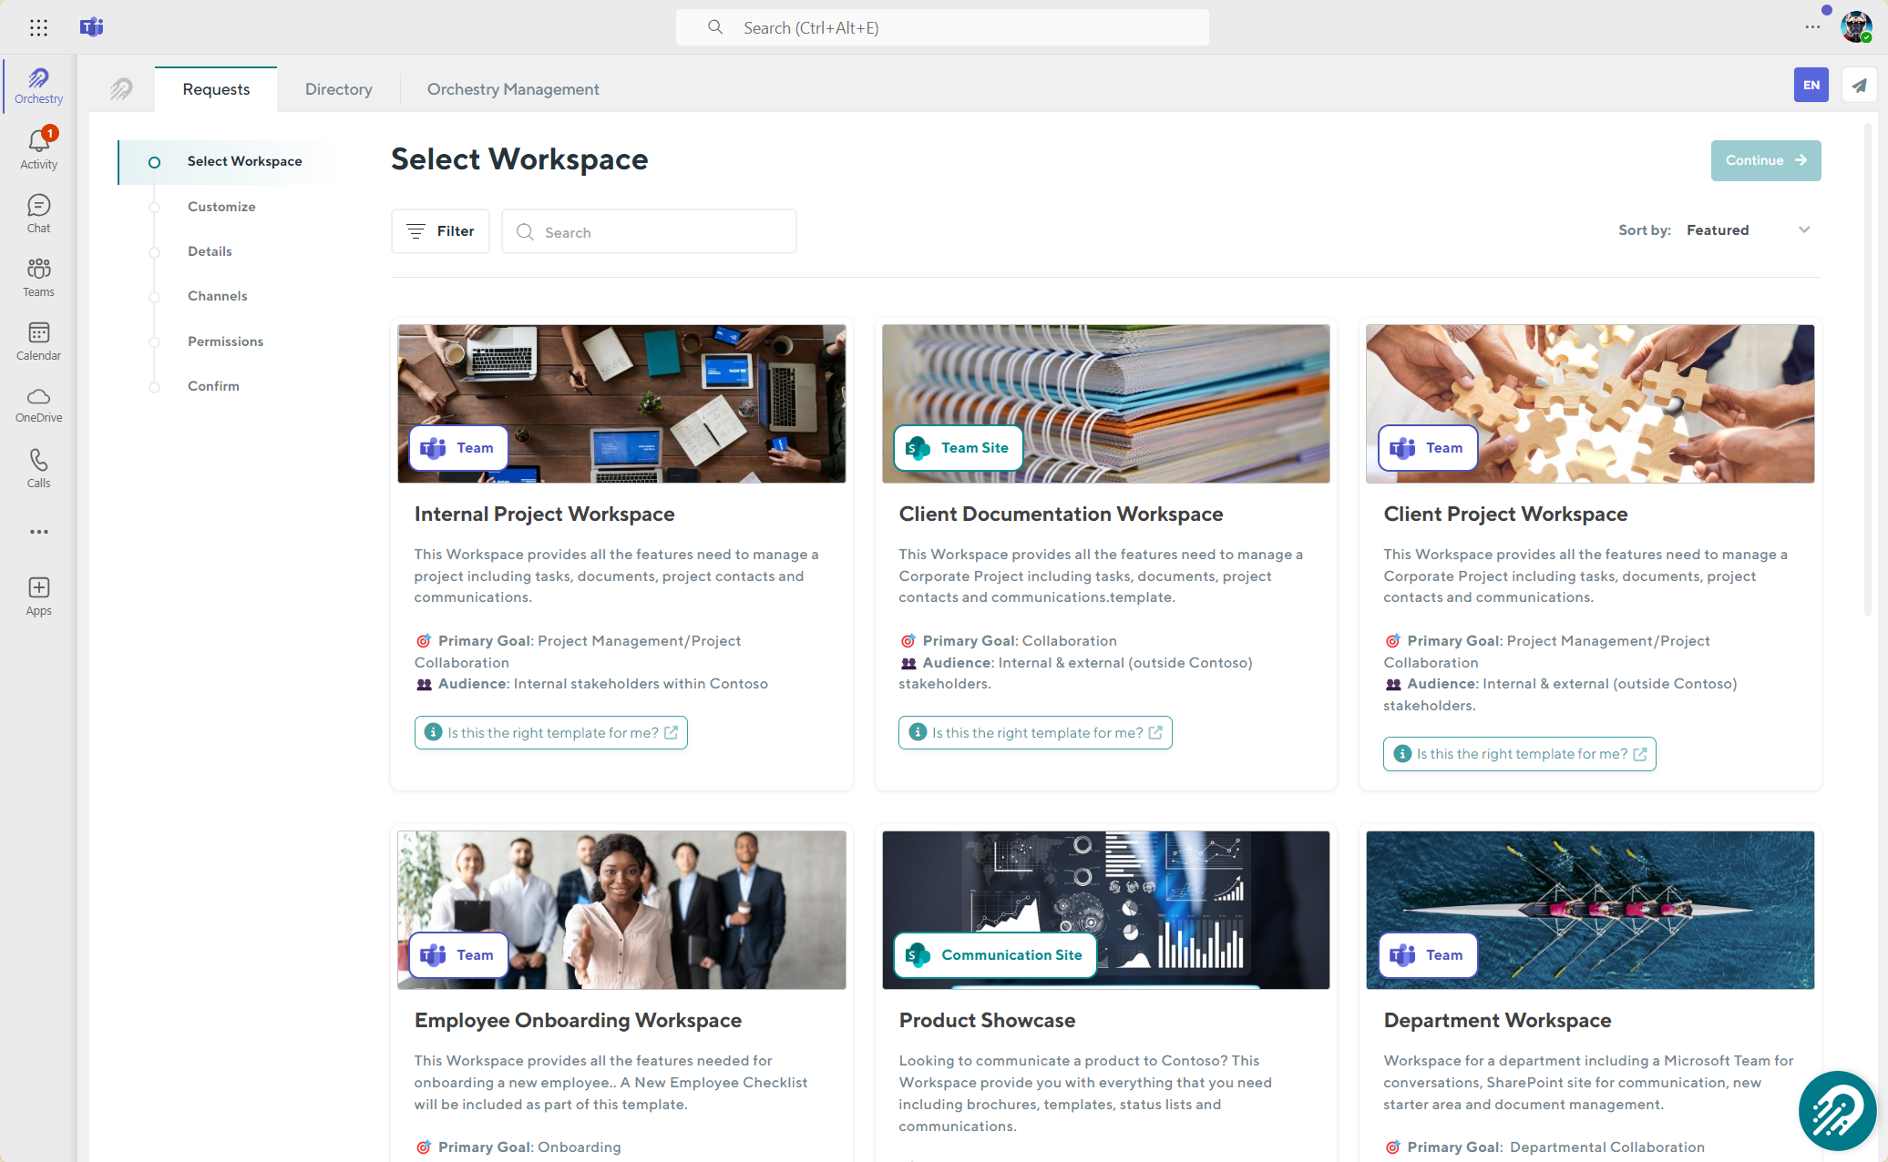
SELECT WORKSPACE

Slide 8
Customize

Slide 9
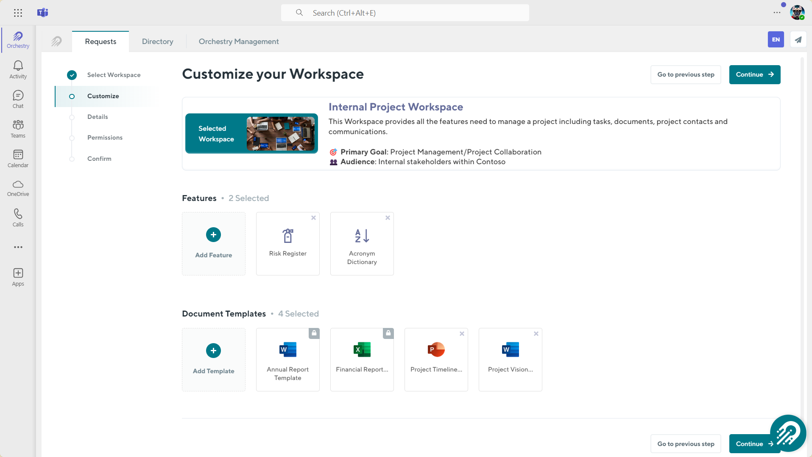
CUSTOMIZE

Slide 10
Details

Slide 11
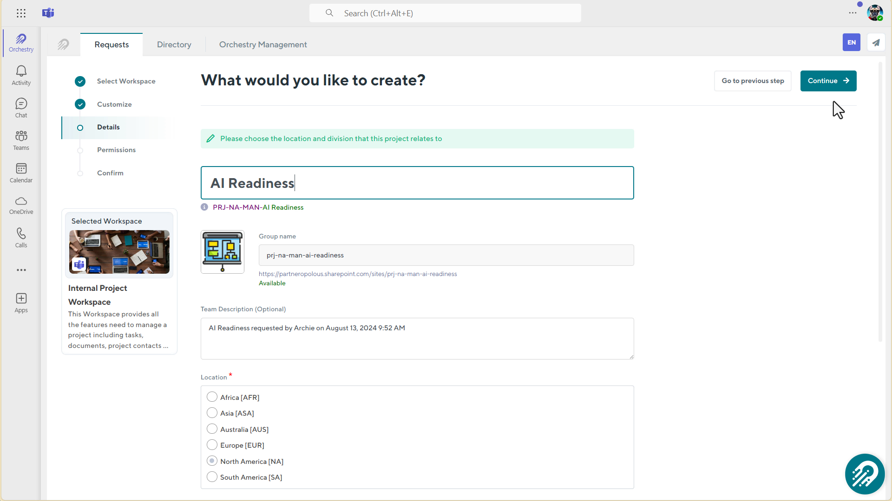
DETAILS

Slide 12
Channels

Slide 13
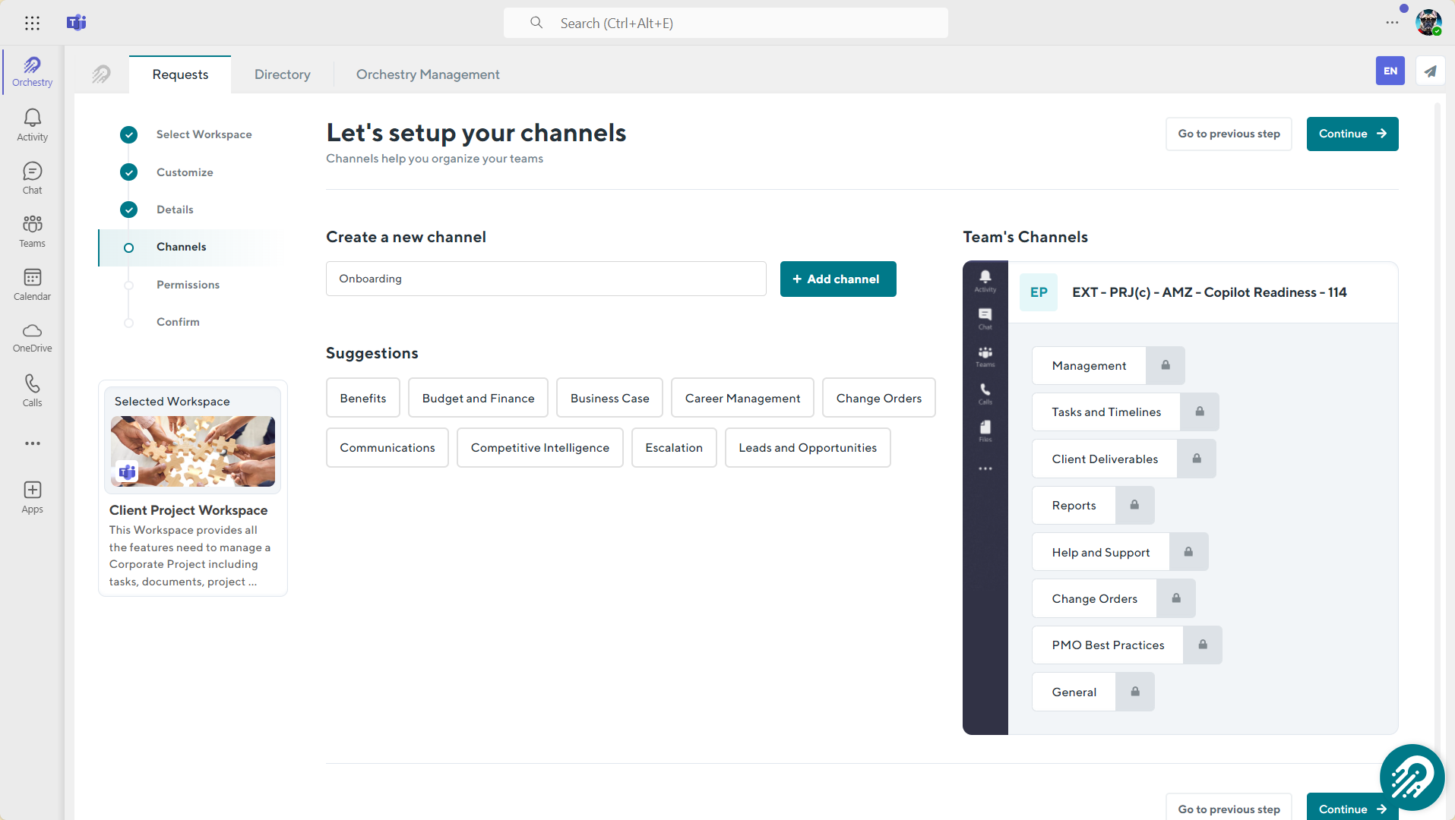
CHANNELS

Slide 14
Permissions

Slide 15
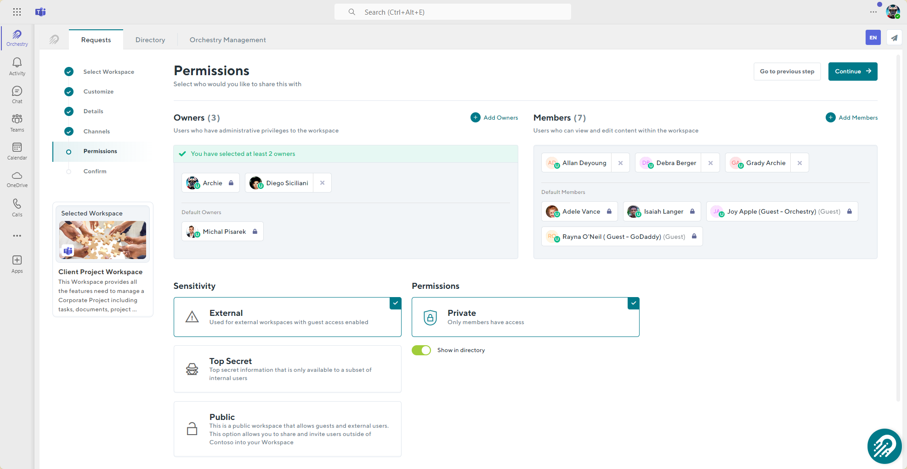
PERMISSIONS

Slide 16
Confirm

Slide 17
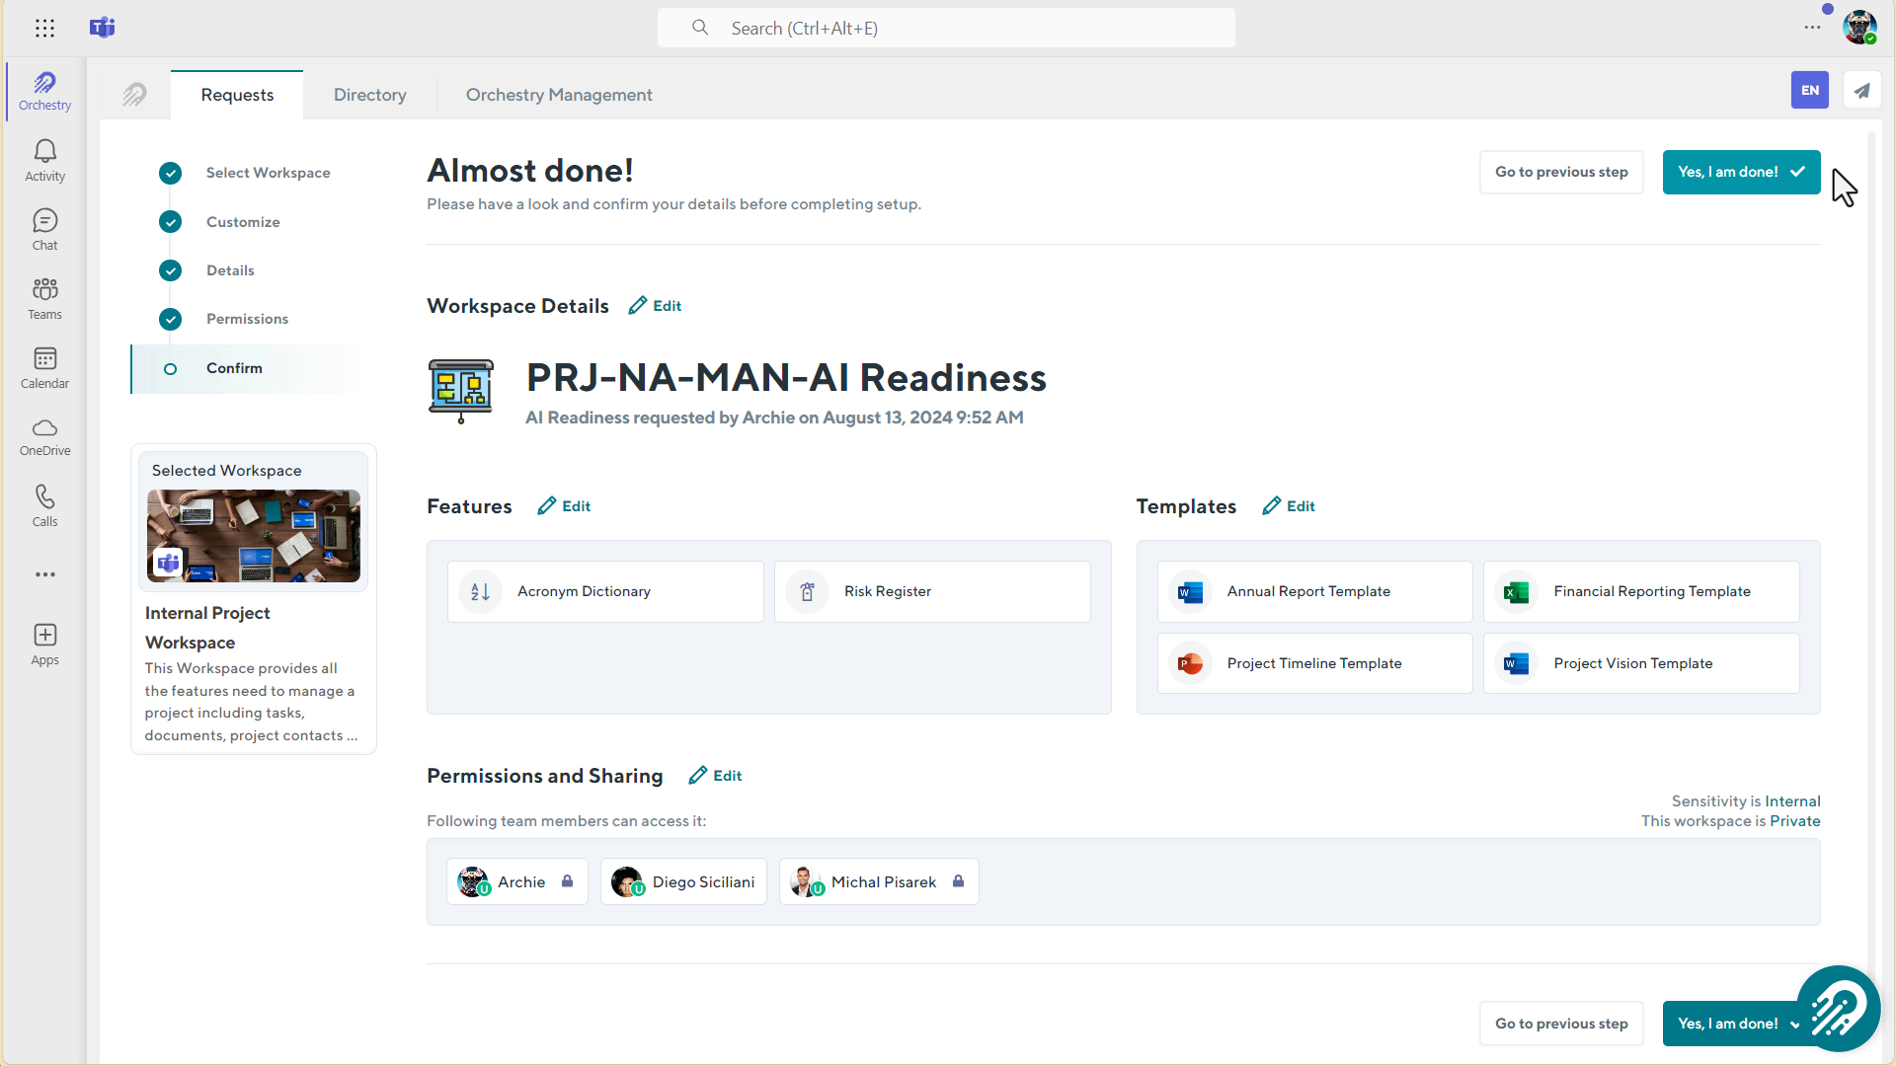
CONFIRM

Slide 18
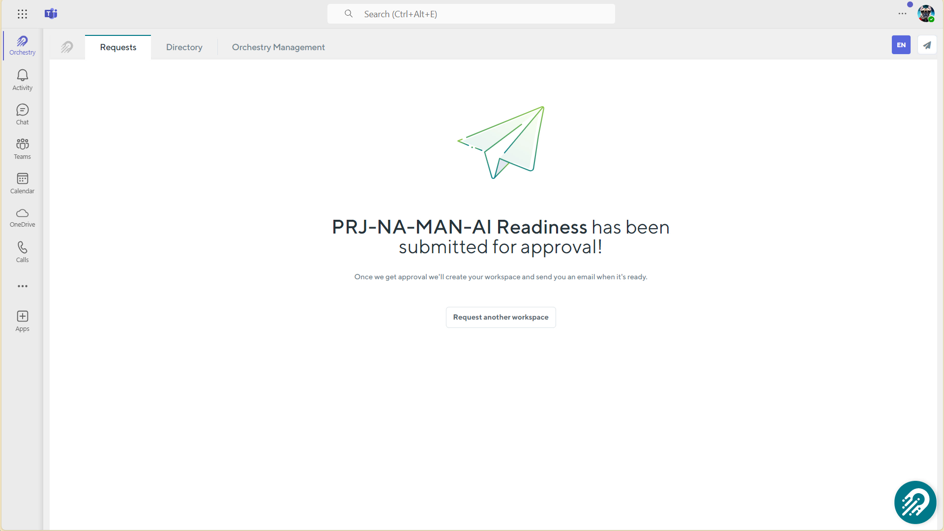
CONFIRM

Slide 19
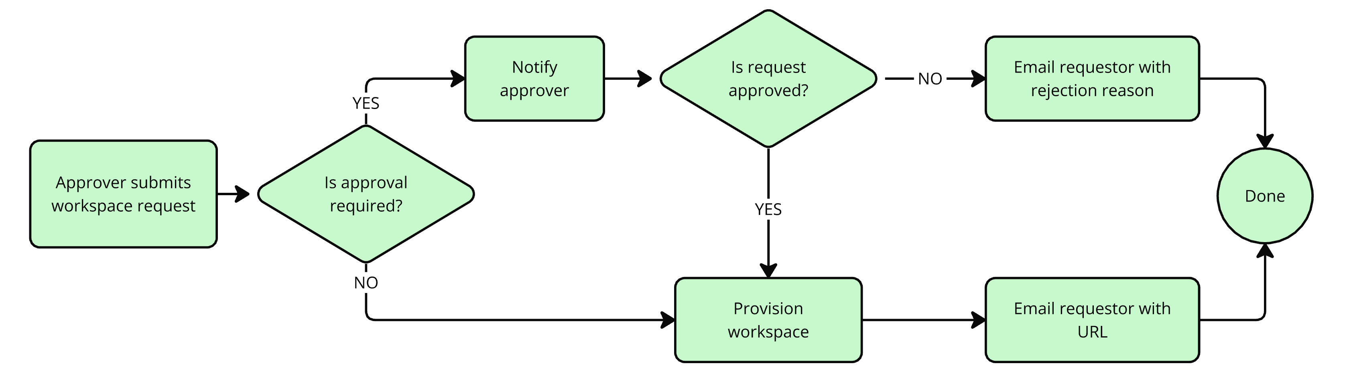
CONFIRM

Slide 20
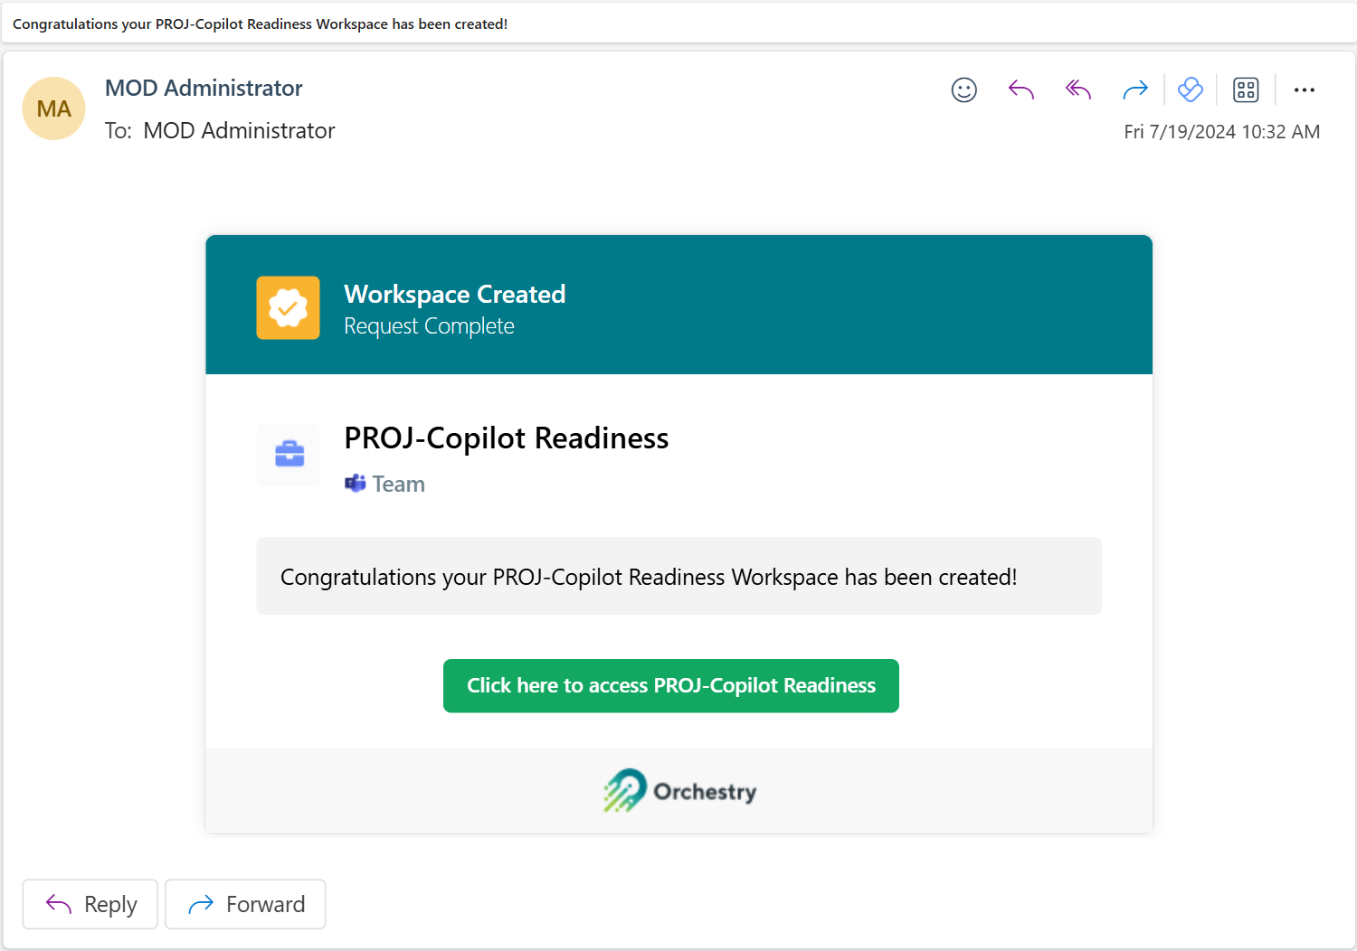
CONFIRM

Slide 21
Thank You
Orchestry’s next webinar
#Orchestry #WorkMadeSimple
orchestry.com →
hello@orchestry.com
Twitter Orchestrysoft
LinkedIn Orchesty
#
Hashtag #Orchestry

