Slide 1

How to
Add Guests to your Workspaces
with Orchestry

Slide 2
What is a Guest Request?

Slide 3
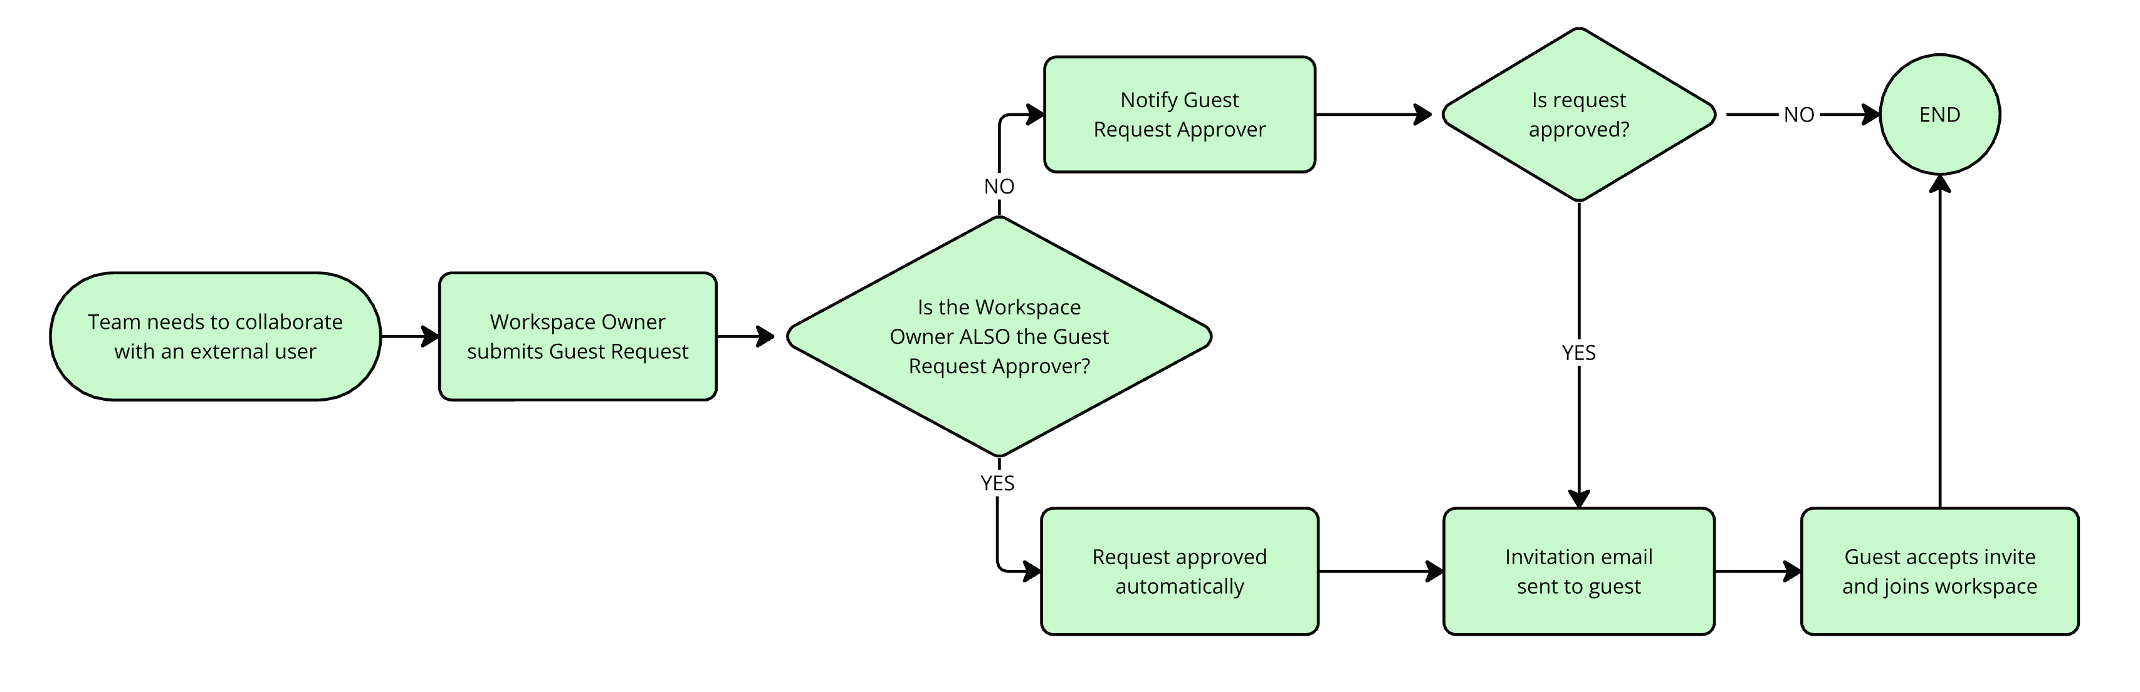
WHAT IS A GUEST REQUEST?

Slide 4
Only Workspace Owners Can Submit Guest Requests
Group members and other guests cannot submit requests.

Slide 5
There Are Two Key Scenarios For Adding Guests:
Adding a guest to an EXISTING workspace
Adding a guest when requesting a NEW workspace

Slide 6
How Do I Add Guests to Existing Teams Workspaces?

Slide 7
Only Workspace Owners Can Submit Guest Requests
Group members and other guests cannot submit requests.

Slide 8
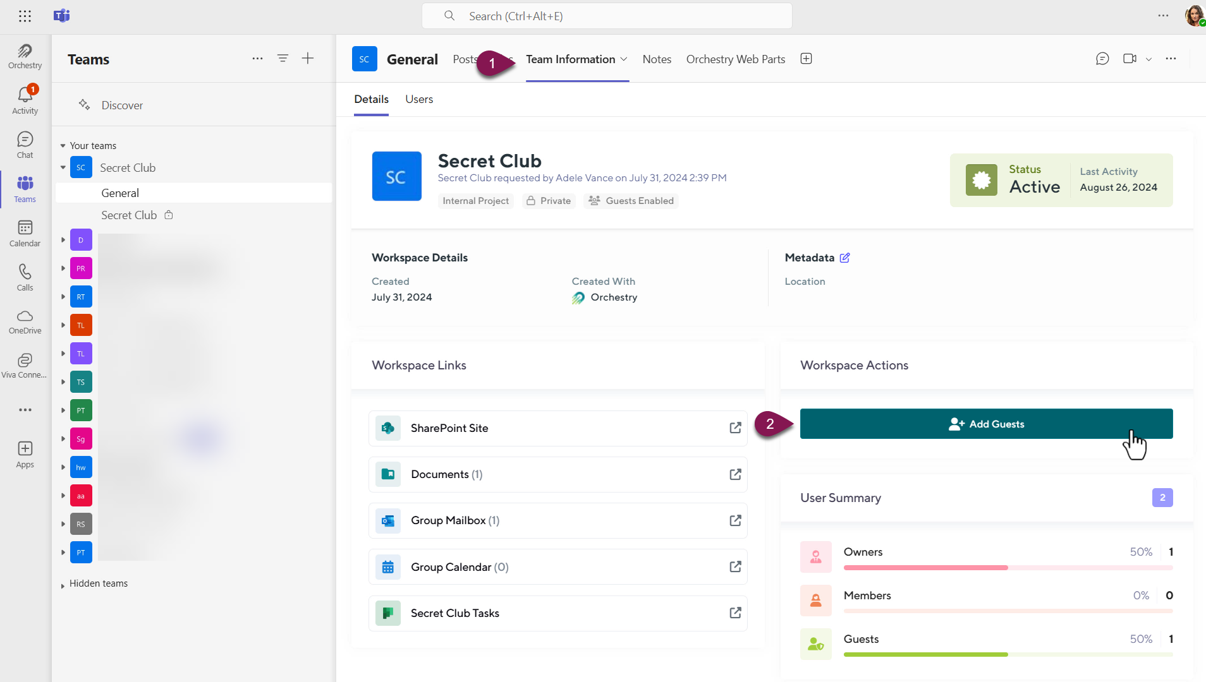
HOW TO ADD GUESTS INTO EXISTING WORKSPACE - MICROSOFT TEAMS
Notes:
Open the Team Information Tab and click the ‘Add Guests’ button to start a new request

Slide 9
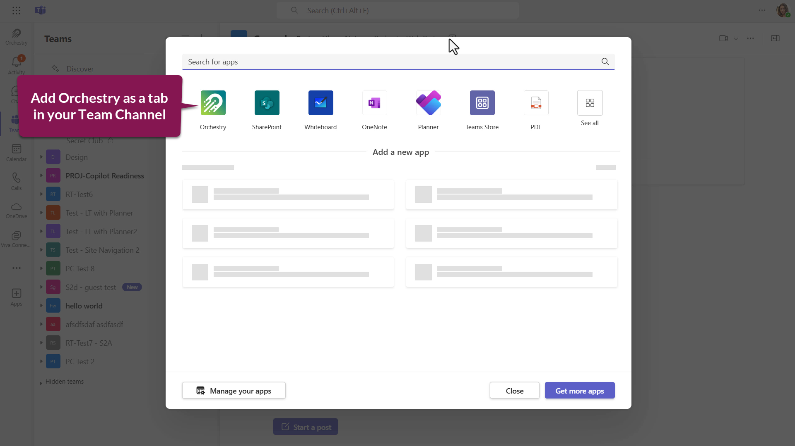
HOW TO ADD GUESTS INTO EXISTING WORKSPACE - MICROSOFT TEAMS
Notes:
If the Workspace Information Tab is missing from your team channels, add the Orchestry app into your team.

Slide 10
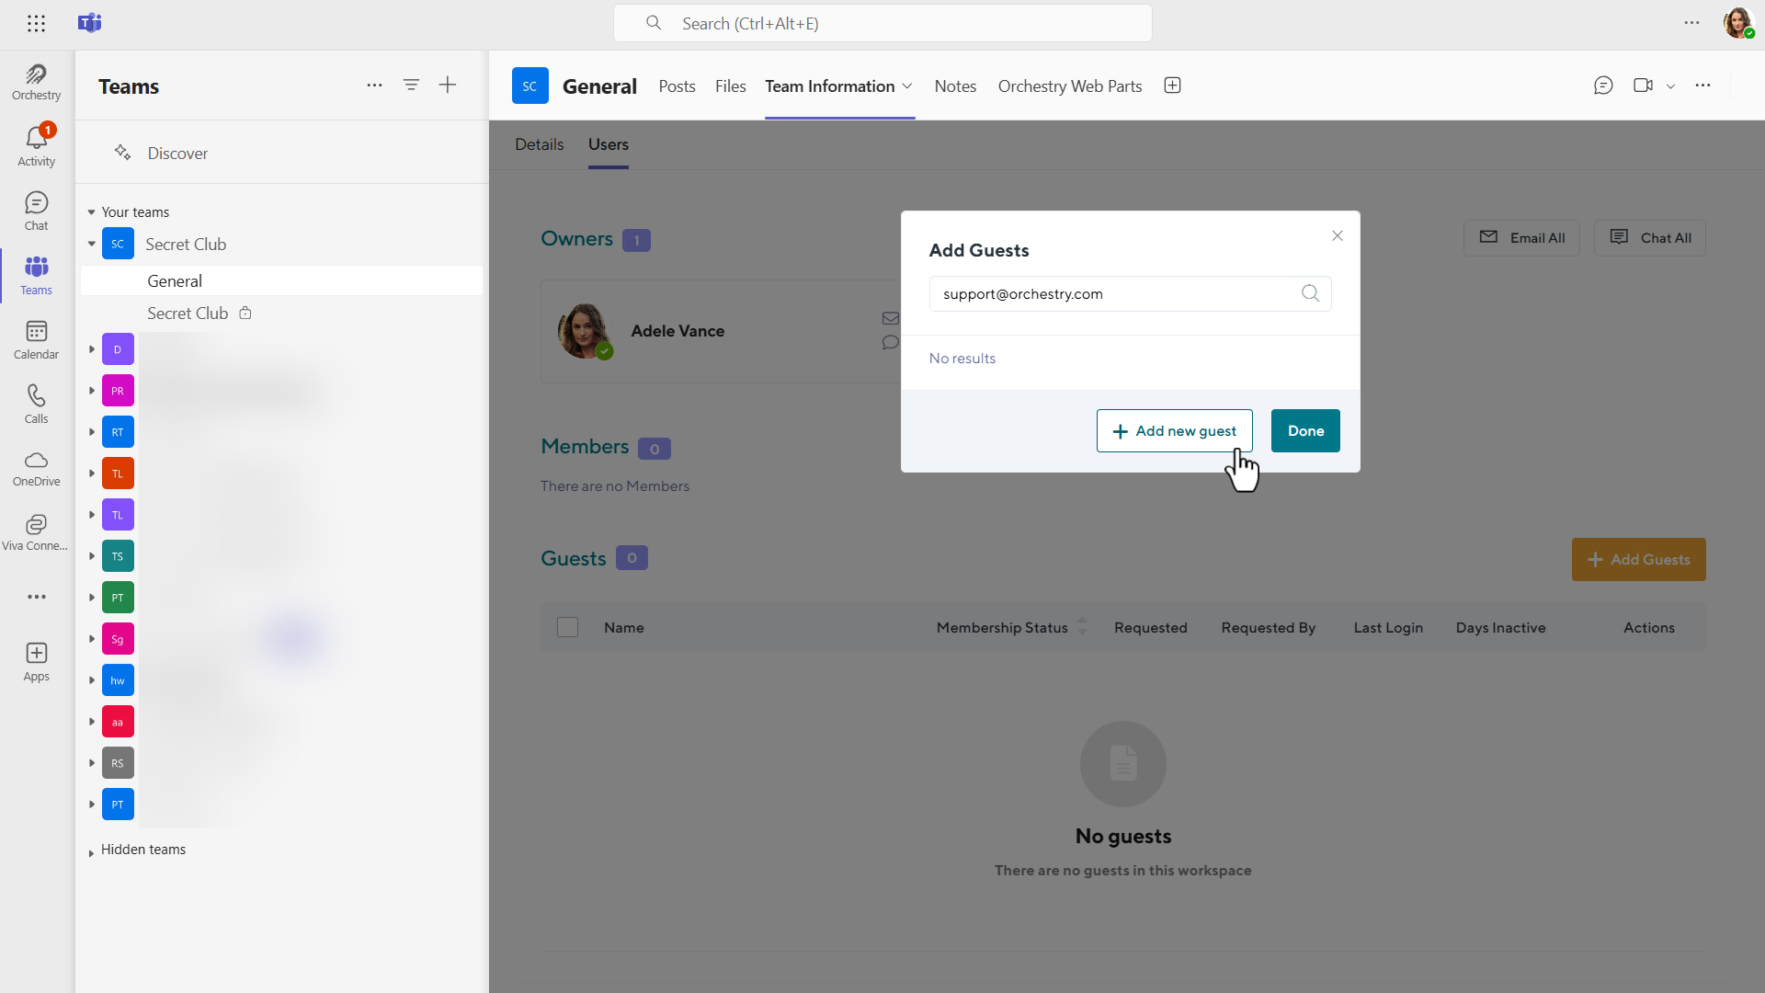
HOW TO ADD GUESTS INTO EXISTING WORKSPACE - MICROSOFT TEAMS

Slide 11
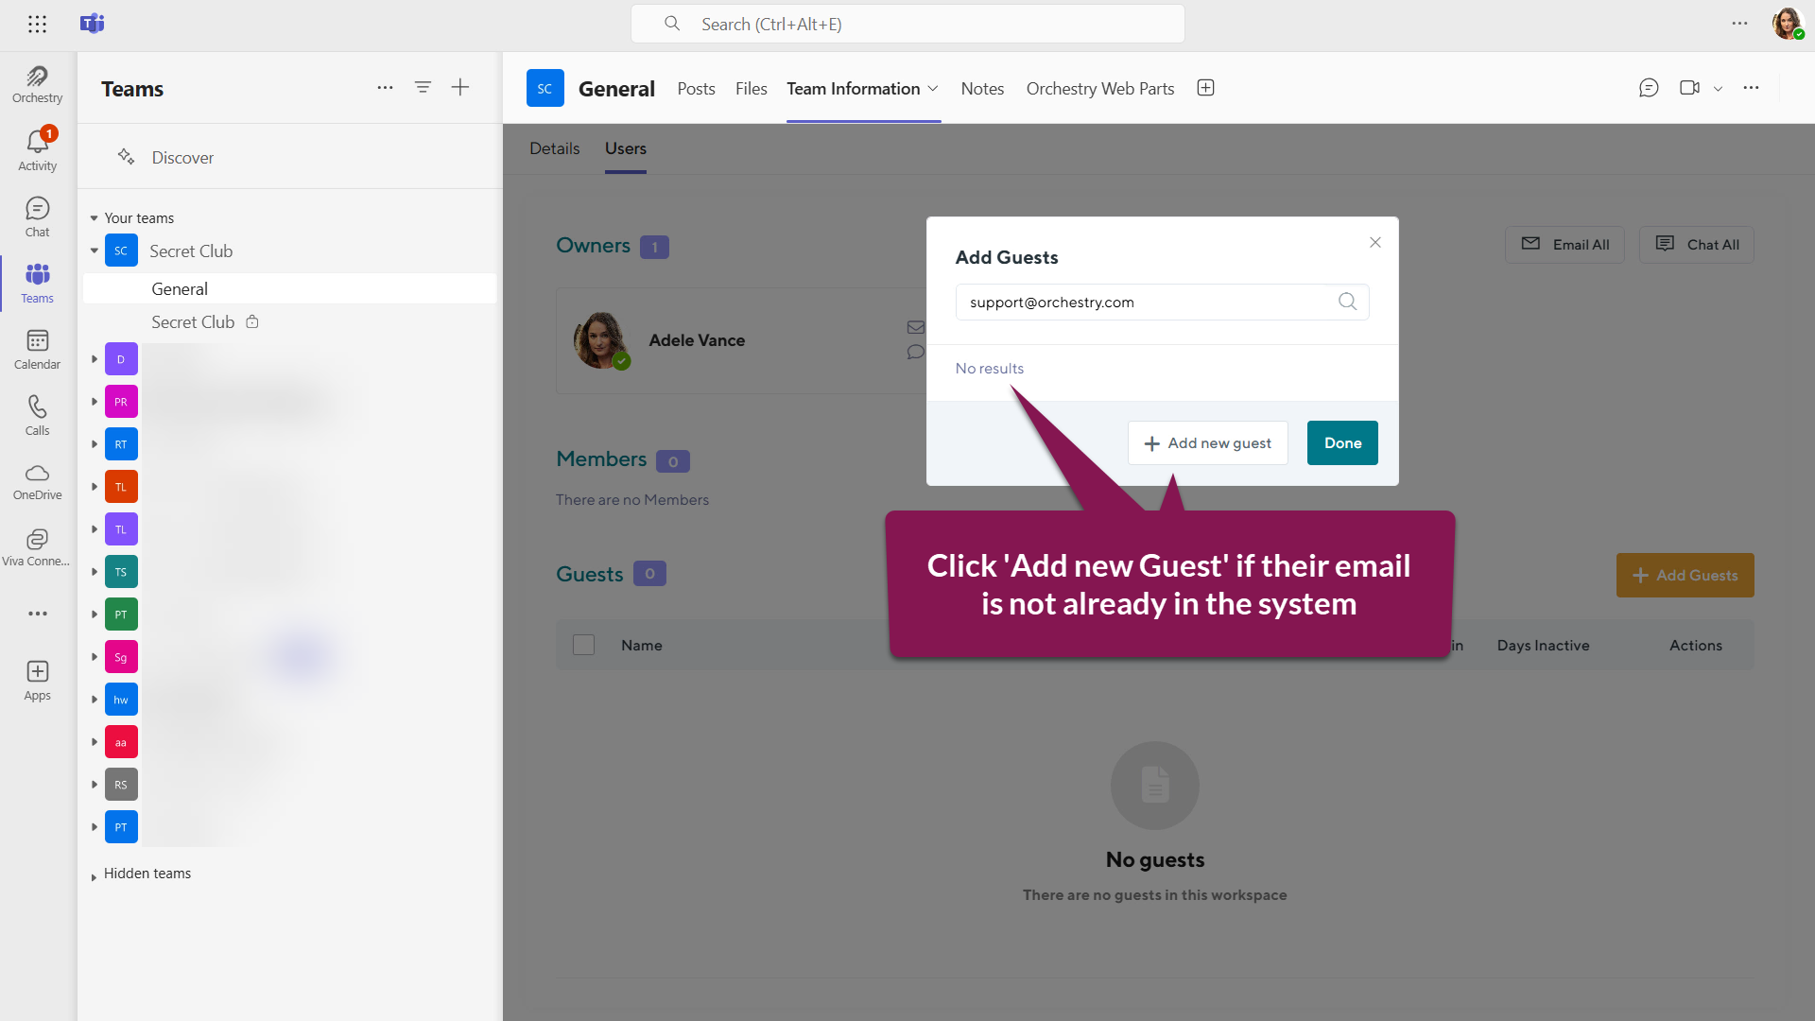
HOW TO ADD GUESTS INTO EXISTING WORKSPACE - MICROSOFT TEAMS

Slide 12
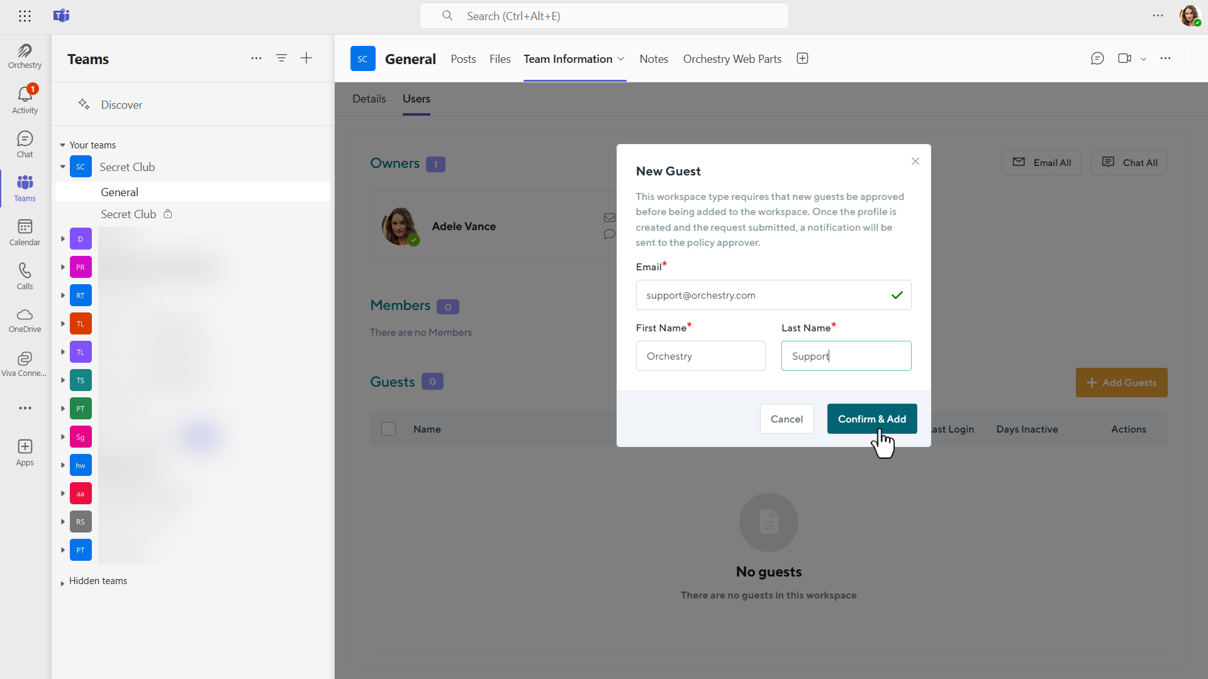
HOW TO ADD GUESTS INTO EXISTING WORKSPACE - MICROSOFT TEAMS

Slide 13
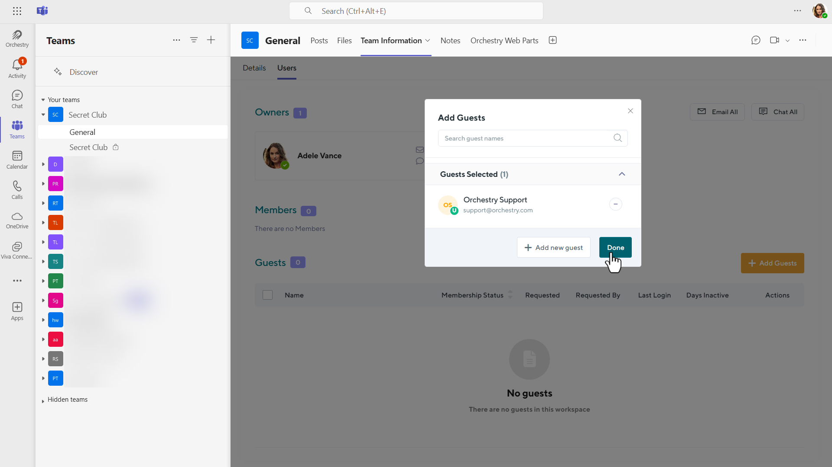
HOW TO ADD GUESTS INTO EXISTING WORKSPACE - MICROSOFT TEAMS

Slide 14
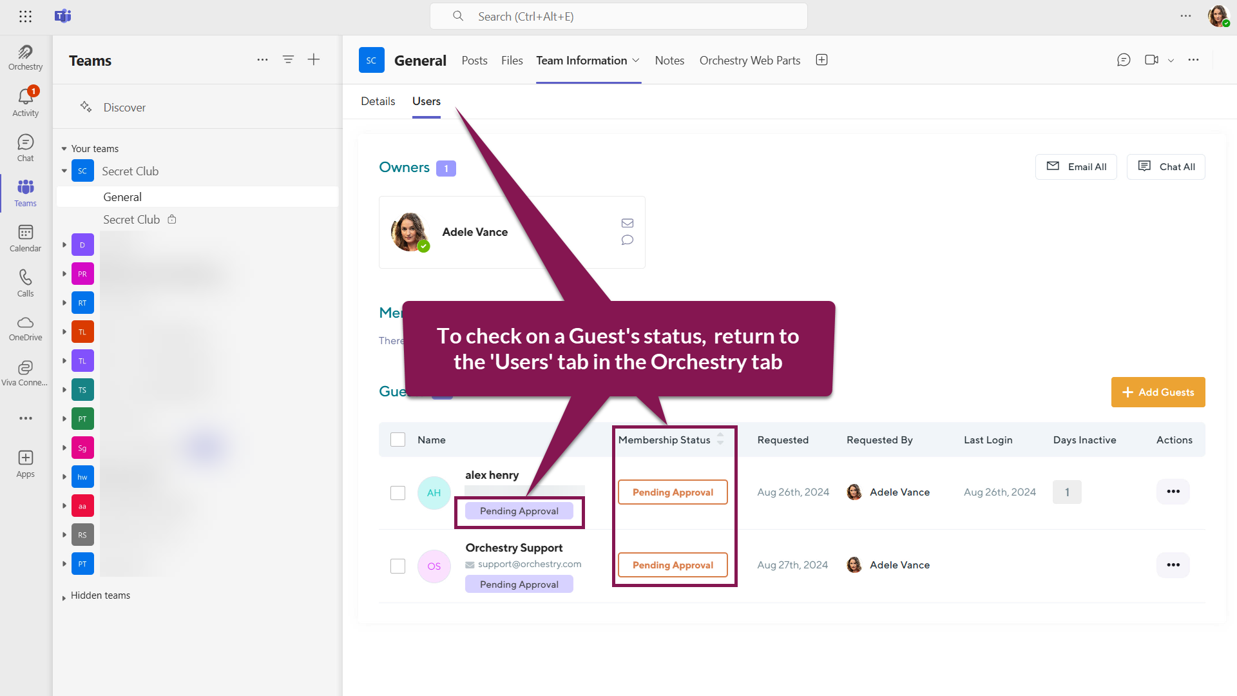
HOW TO ADD GUESTS INTO EXISTING WORKSPACE - MICROSOFT TEAMS

Slide 15
How Do I Add Guests to My Existing SharePoint Workspace?

Slide 16
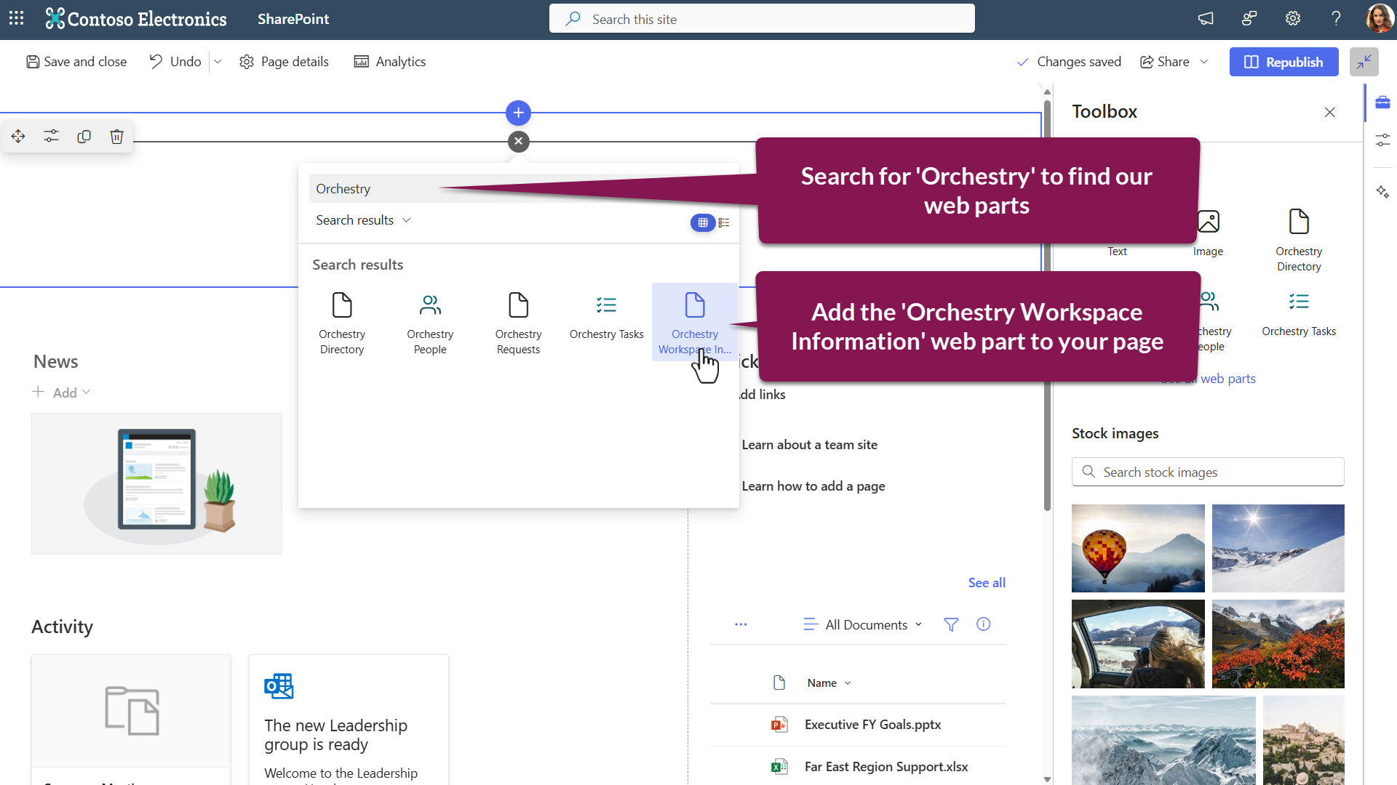
HOW TO ADD GUESTS INTO EXISTING WORKSPACE – SHAREPOINT TEAM SITES

Slide 17
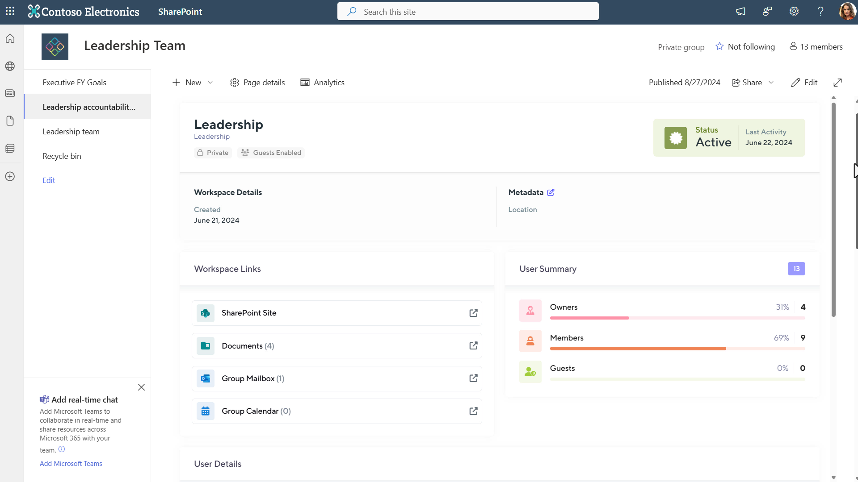
HOW TO ADD GUESTS INTO EXISTING WORKSPACE – SHAREPOINT TEAM SITES

Slide 18
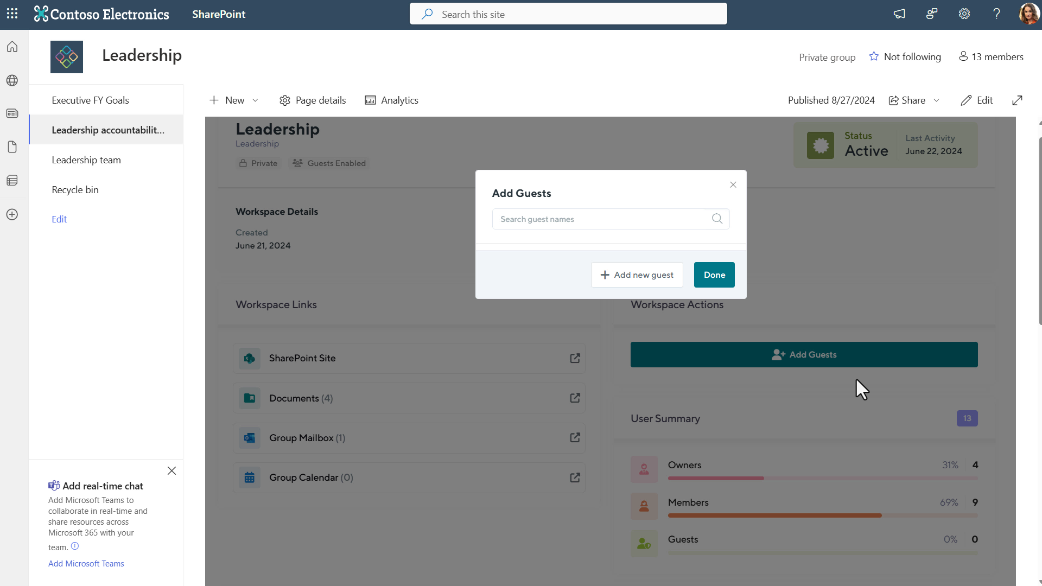
HOW TO ADD GUESTS INTO EXISTING WORKSPACE – SHAREPOINT TEAM SITES

Slide 19
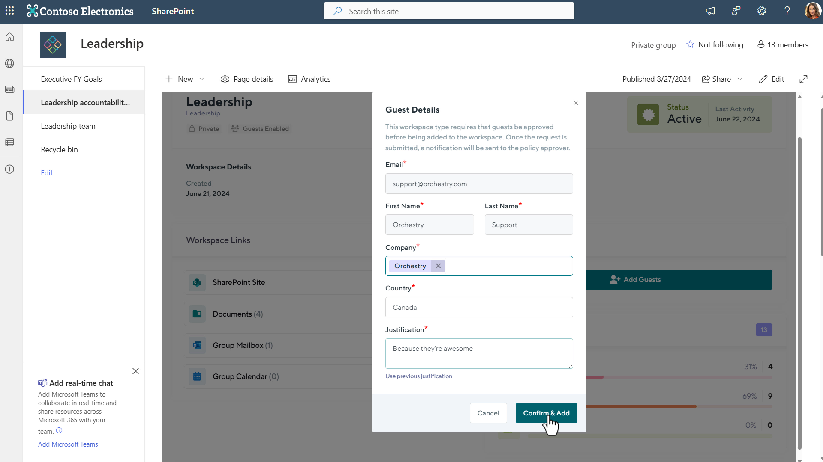
HOW TO ADD GUESTS INTO EXISTING WORKSPACE – SHAREPOINT TEAM SITES

Slide 20
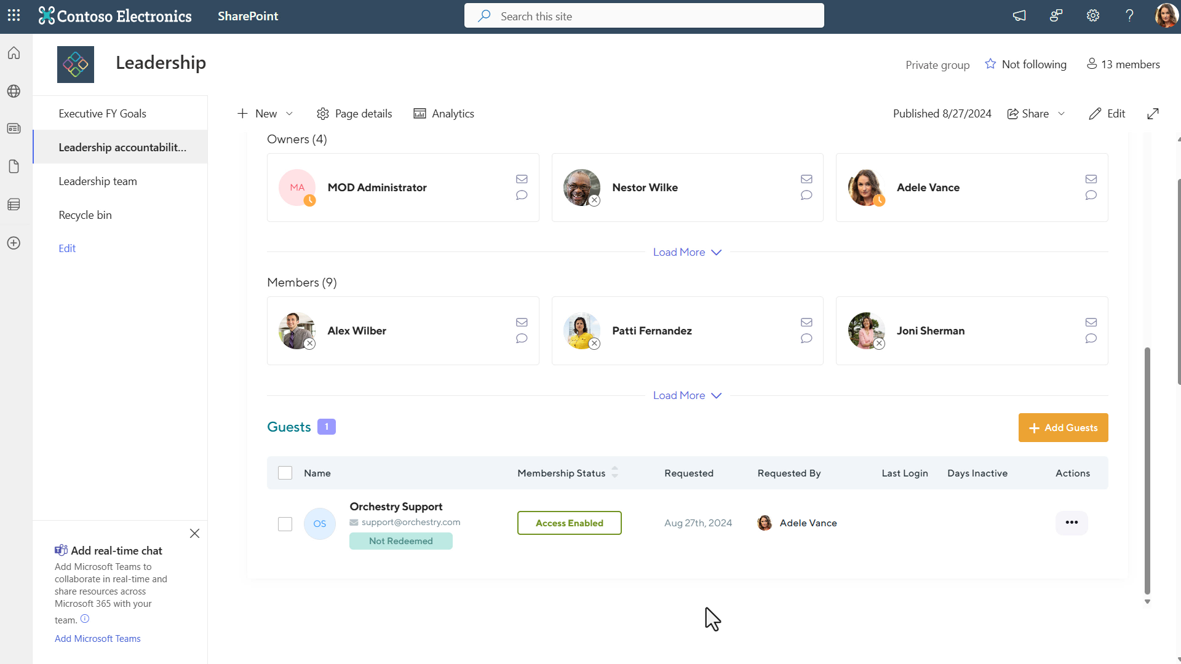
HOW TO ADD GUESTS INTO EXISTING WORKSPACE – SHAREPOINT TEAM SITES

Slide 21
How Do I Add Guests When Requesting a NEW workspace?

Slide 22
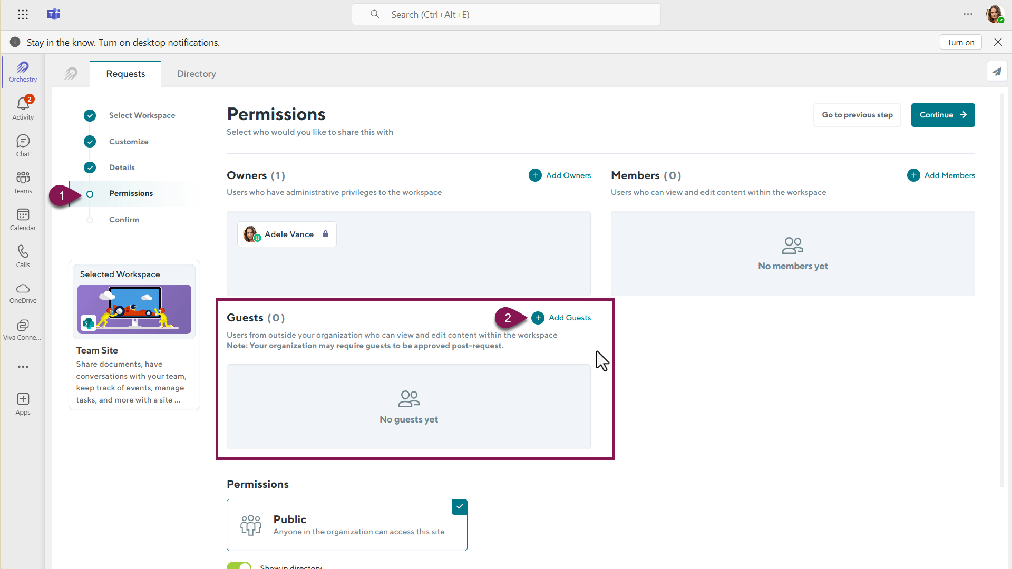
HOW TO ADD GUESTS INTO EXISTING WORKSPACE IN A WORKSPACE REQUEST

Slide 23
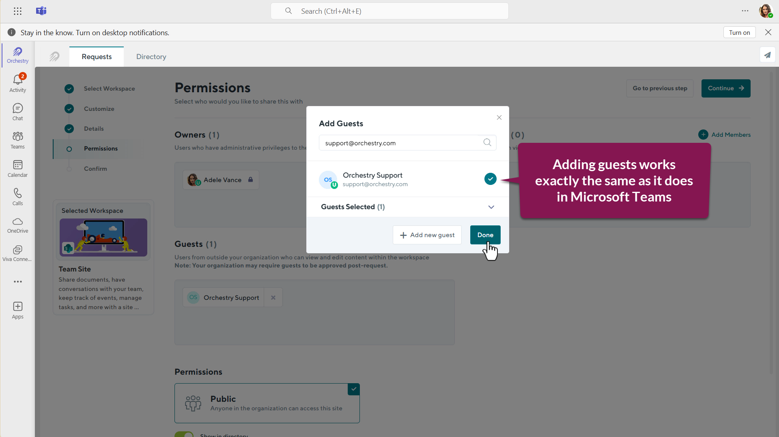
HOW TO ADD GUESTS INTO EXISTING WORKSPACE IN A WORKSPACE REQUEST

Slide 24
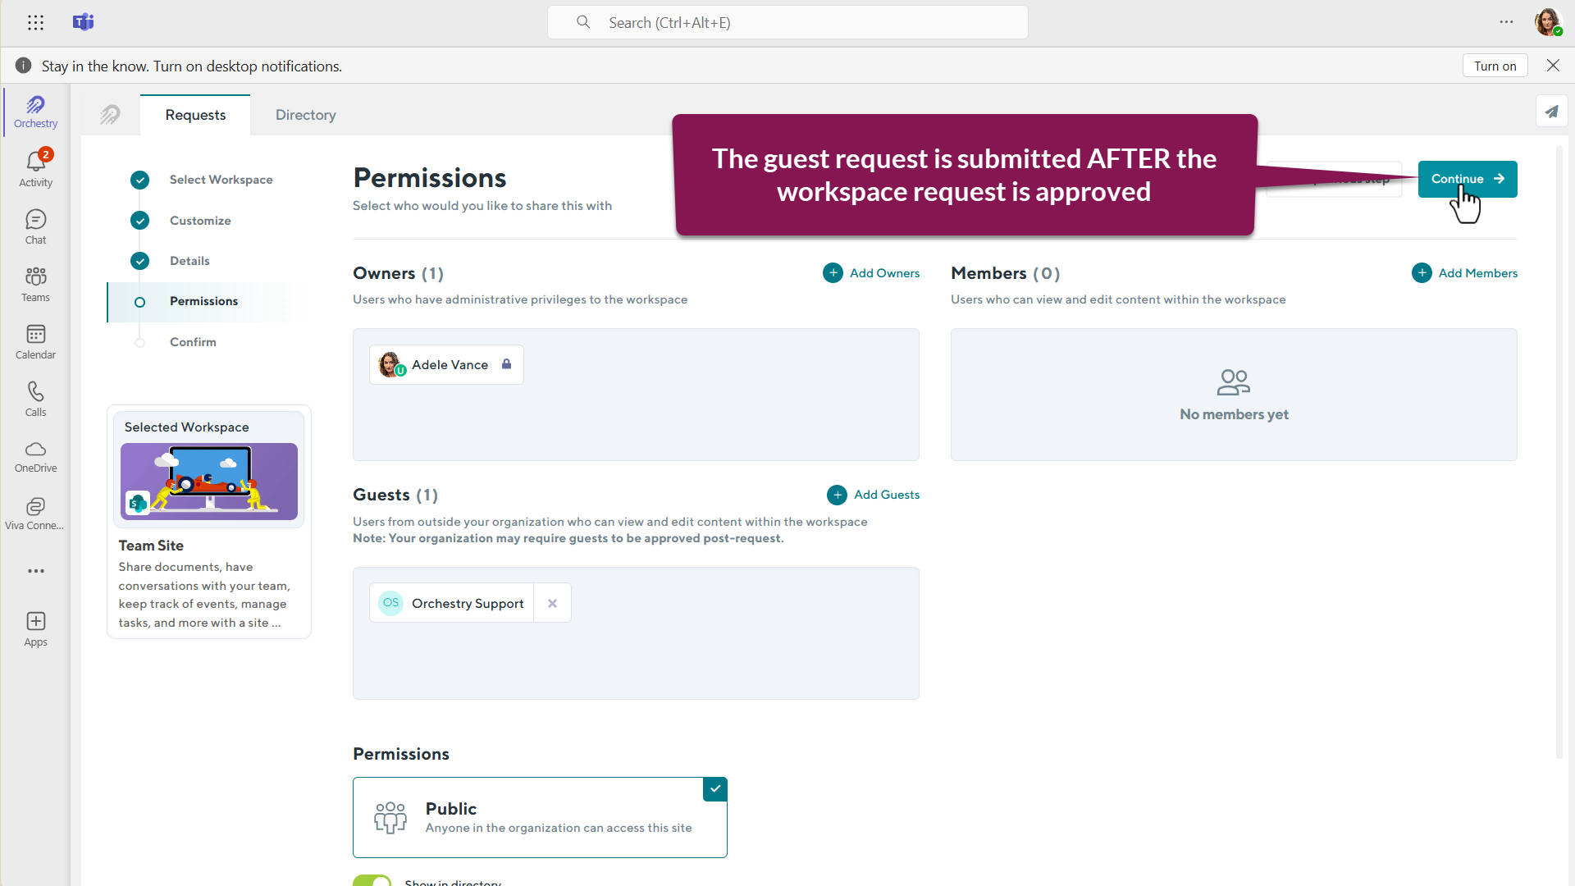
HOW TO ADD GUESTS INTO EXISTING WORKSPACE IN A WORKSPACE REQUEST

Slide 25
How Do I Approve Guest Requests?

Slide 26
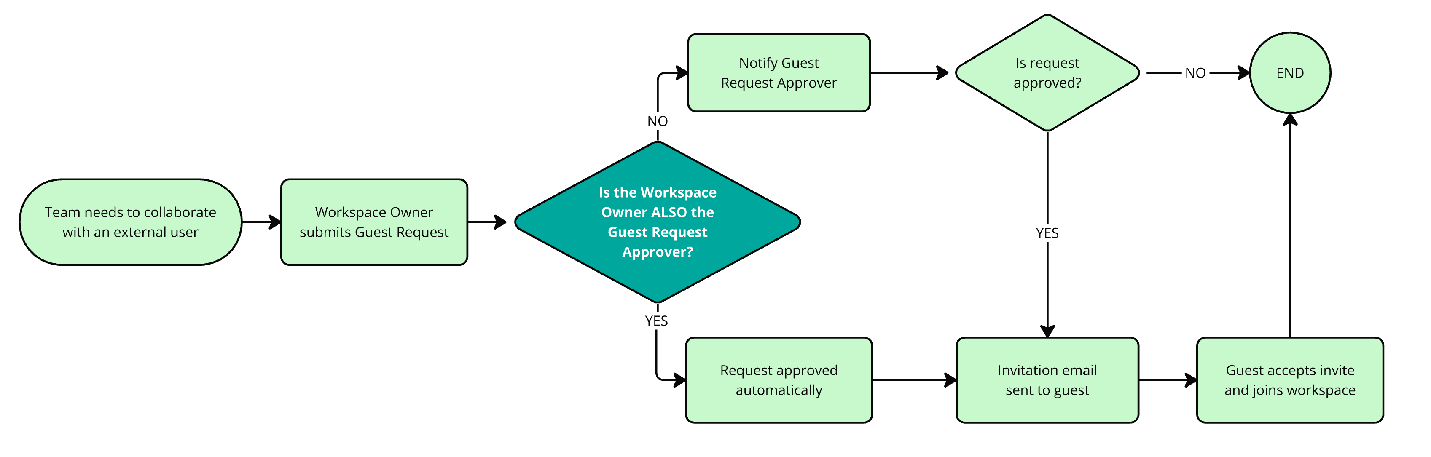
HOW TO APPROVE GUEST REQUESTS
Notes:
All guest requests are submitted for approval BEFORE the guest is sent an email invite.
If your Guest Request policy is configured to make the workspace owner the Guest Approver, the request is approved automatically, and the email invitation is sent within a few minutes.
If your Guest Request policy is configured for another user or group to approve the request, they will be notified via email and/or Teams. If they approve the request, the email invitation will be sent out.

Slide 27
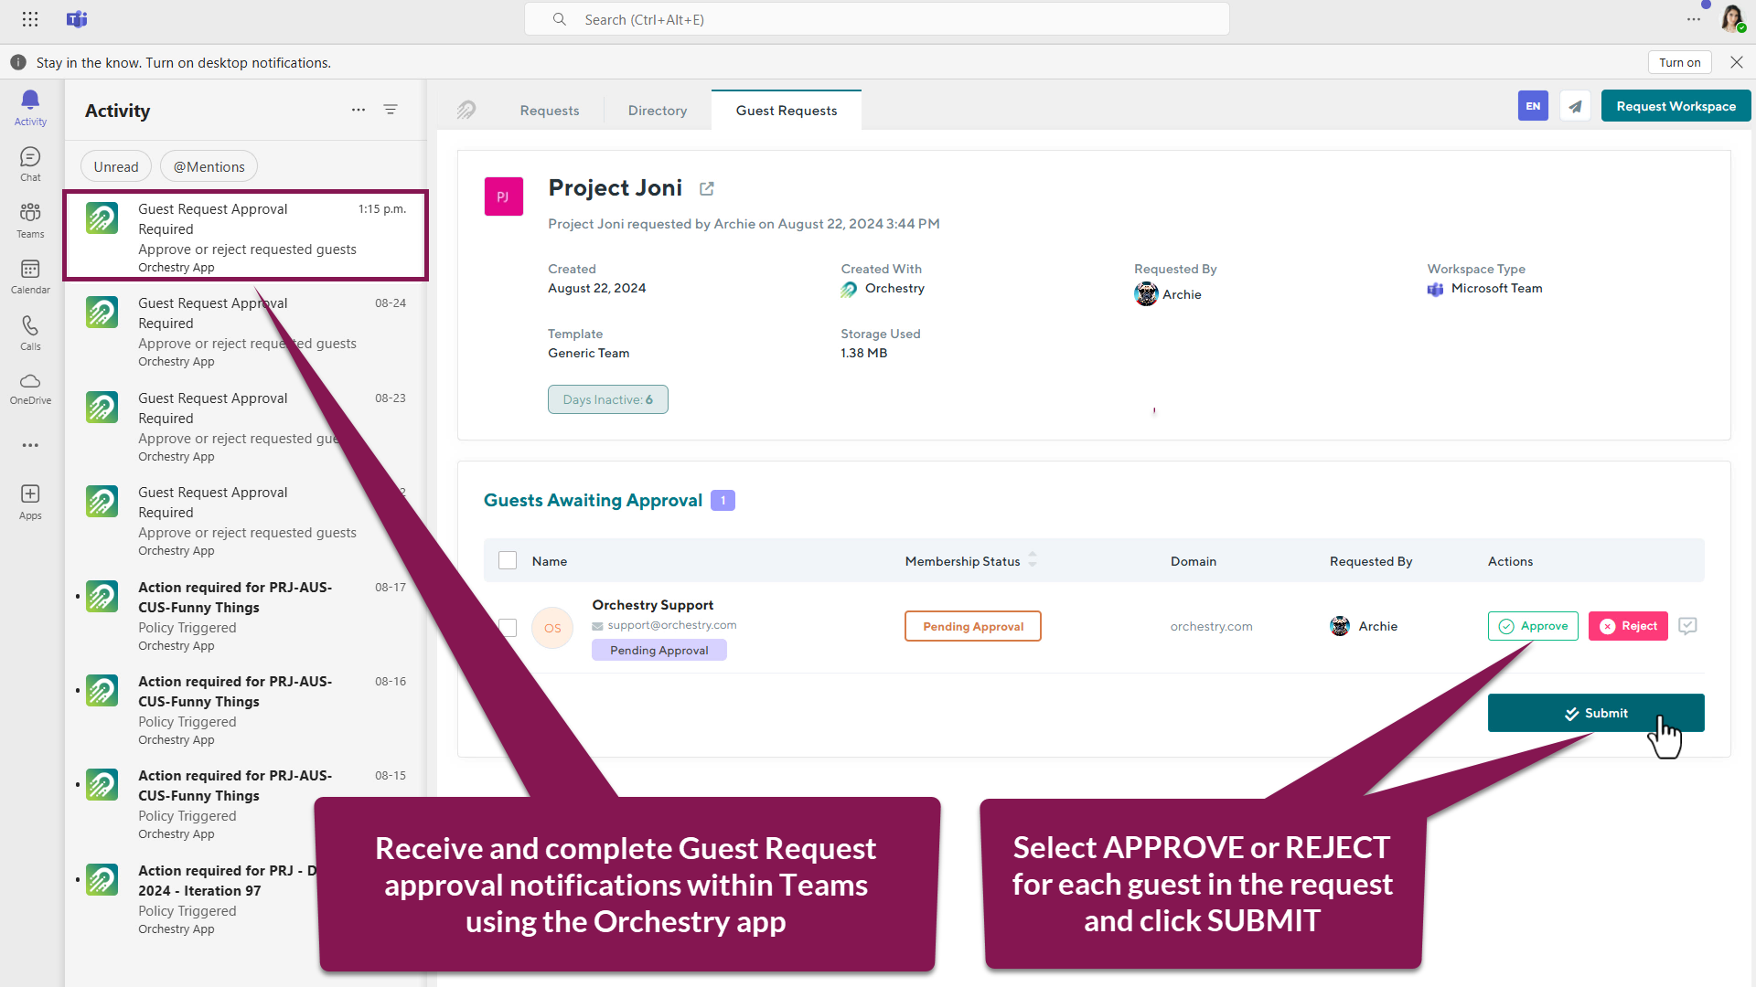
HOW TO APPROVE GUEST REQUESTS

Slide 28
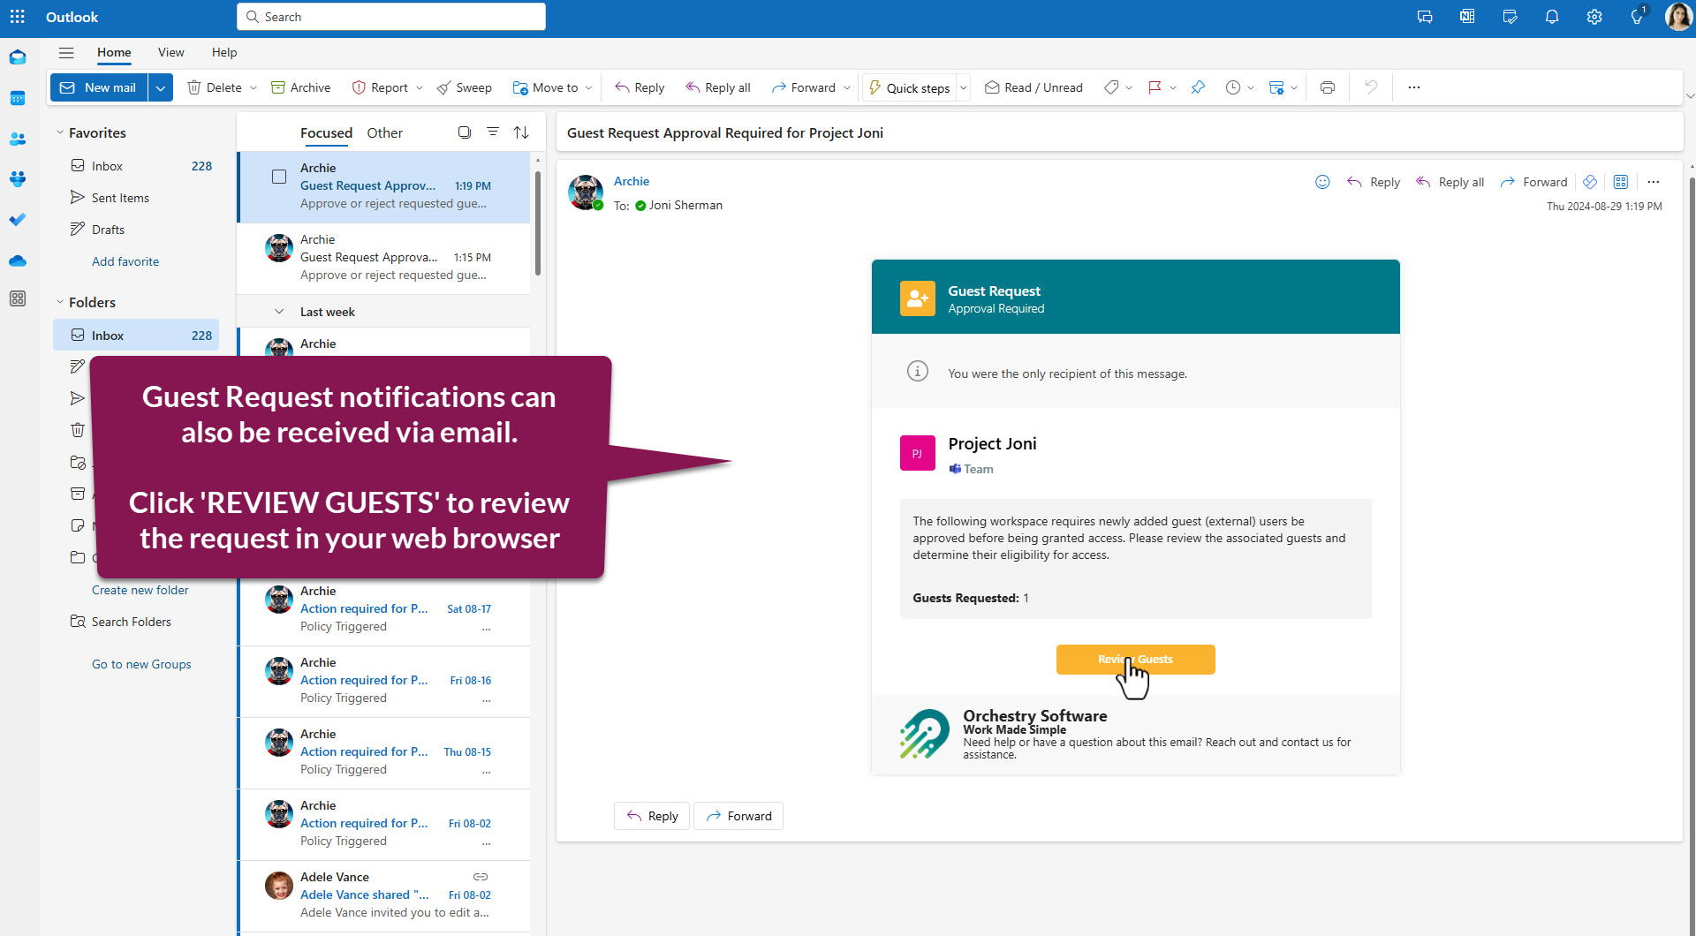
HOW TO APPROVE GUEST REQUESTS

Slide 29
Thank You
Orchestry’s next webinar
#Orchestry #WorkMadeSimple
orchestry.com →
hello@orchestry.com
Twitter Orchestrysoft
LinkedIn Orchesty
#
Hashtag #Orchestry

